Slide 1
IT 356: Introduction To Computer Graphics (Lecture 21)
School of Information Technology
Illinois State University
Dr. Qi Zhang, Spring 2024

Slide 2
Materials

Slide 3
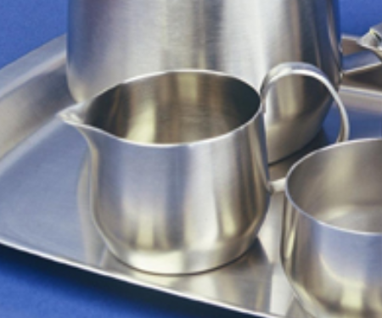
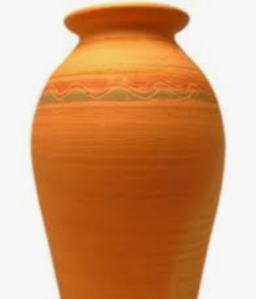
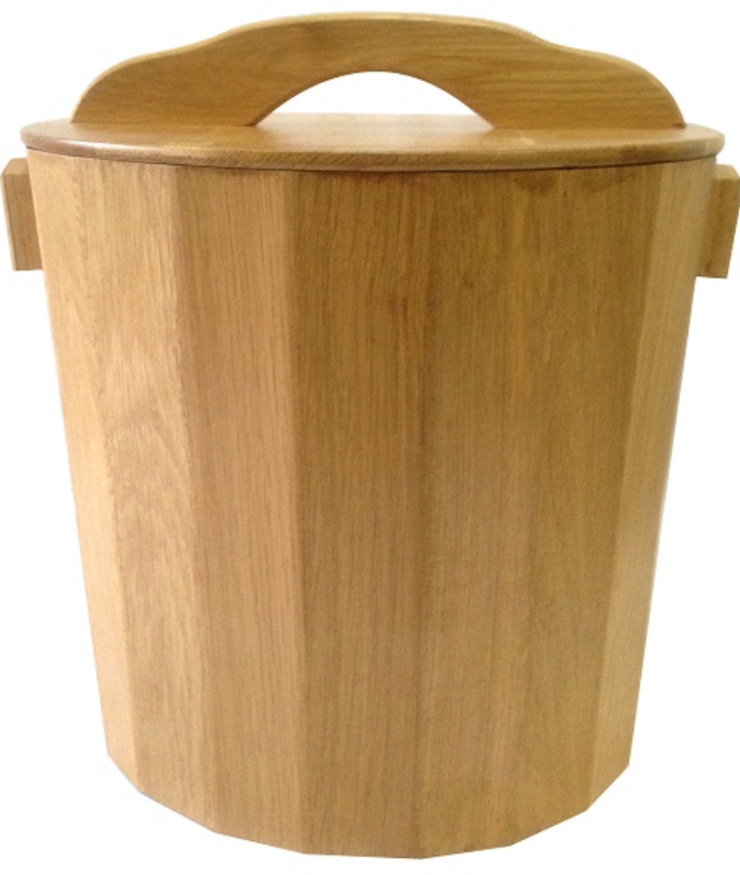
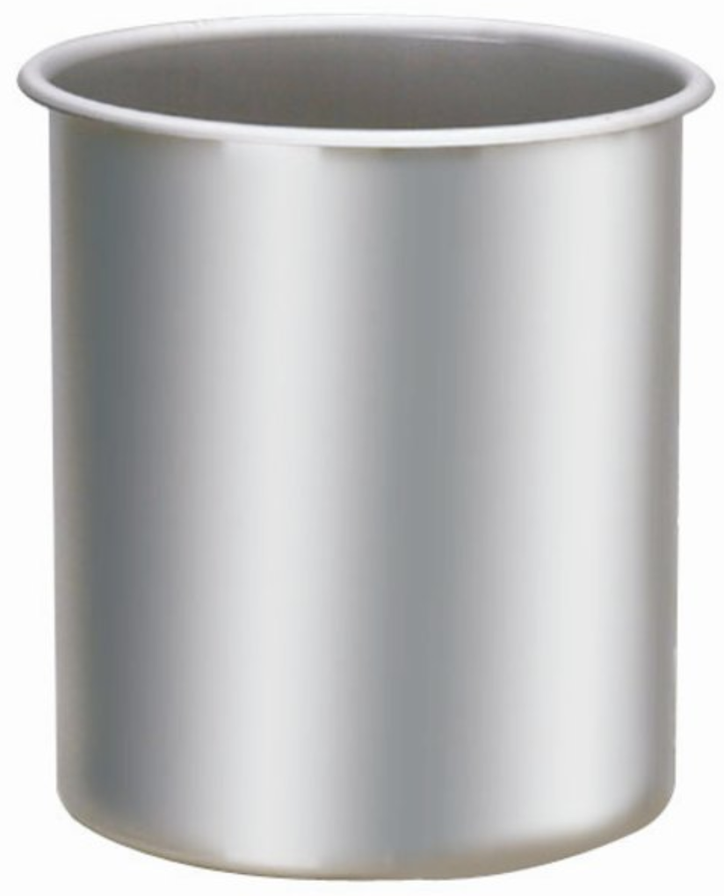
Introduction
In the real world, each object reacts differently to light.
Steel objects are often shinier than a clay vase
A wooden container does not react the same to light as a steel container.

Slide 4
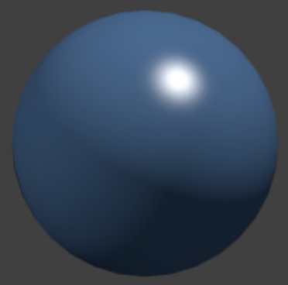
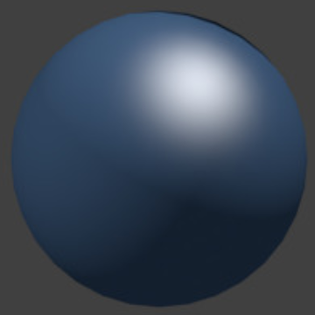
Introduction
Each object responds differently to specular highlights.
Some objects reflect the light without much scattering and deliver a small highlight; others scatter a lot and generate a highlight with a larger radius.
To simulate several types of objects in computer graphics, we have to define material properties specific to each object.

Slide 5
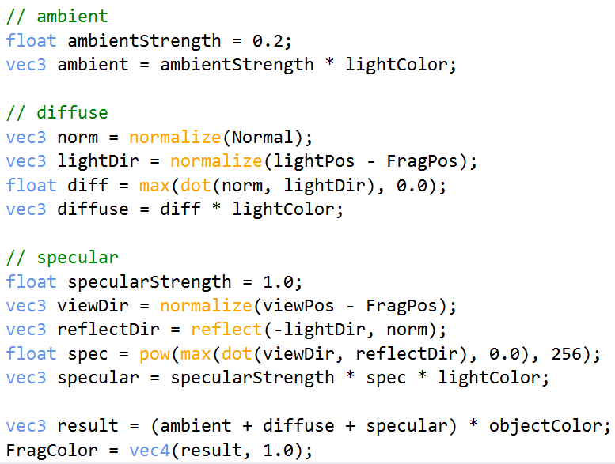
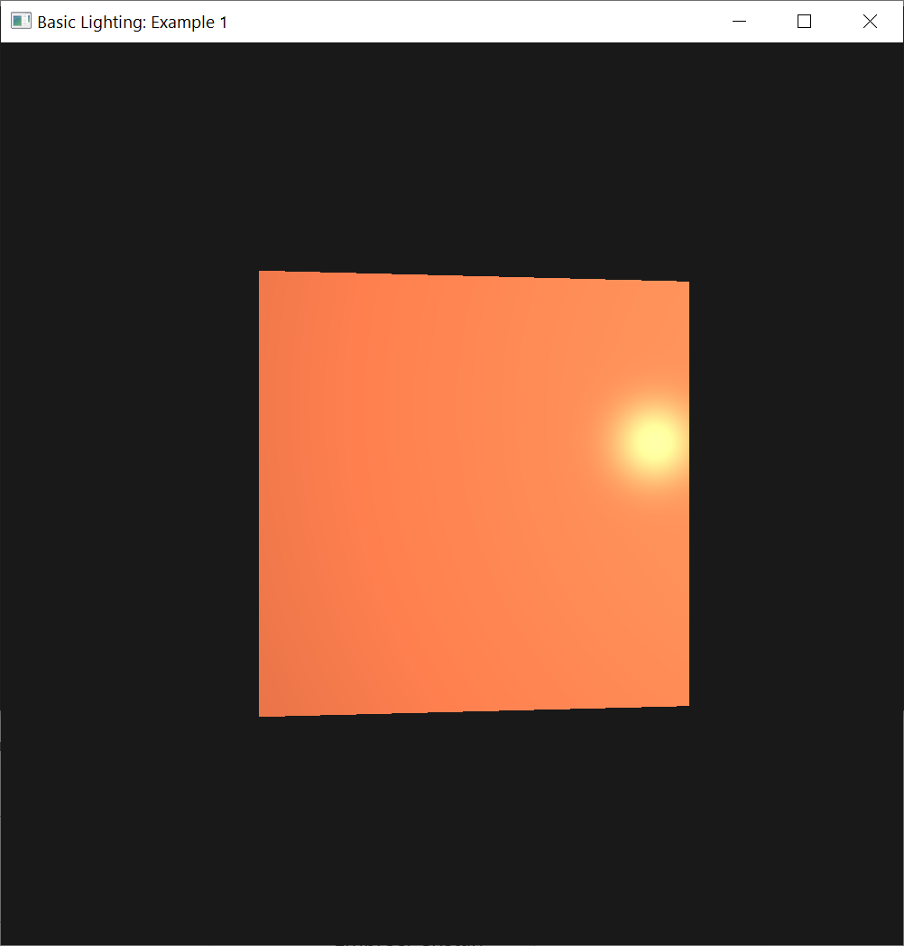
Introduction
Have specified an object color and a light color
To define the visual output of the object, we need to combine object color with an ambient, diffuse, and specular intensity component of the light.

Slide 6
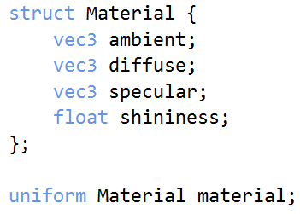
Introduction
To describe objects, we can define a material color for each of the 3 lighting components: ambient, diffuse, and specular.
By specifying a color for each of the components, we have fine-grained control over the color output of the object.
Add a shininess component to those colors, we have all the material properties we need

Slide 7
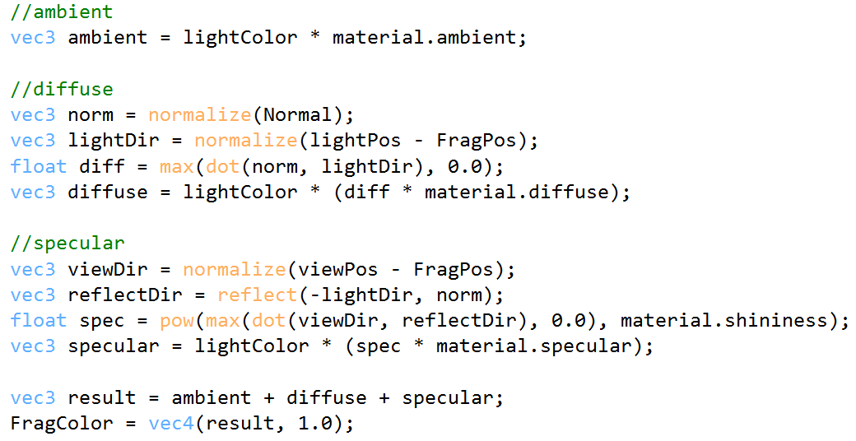
Introduction
In the fragment shader, create a struct to store the object’s material properties.
First, define the layout of the struct and then simply declare a uniform variable with the newly created struct as its type.
The layout of the struct

Slide 8
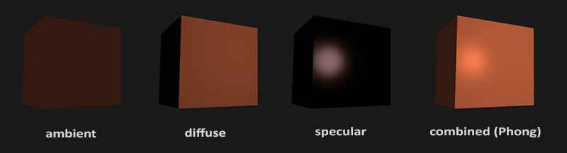
Introduction
We define a color vector for each Phong lighting component.
The ambient material vector defines what color this object reflects under ambient lighting
Usually, the same as the object's color.

Slide 9
Introduction
The diffuse material vector defines the object’s color under diffuse lighting.
The diffuse color is (just like ambient lighting) set to the desired object's color.
The specular material vector sets the color impact of a specular light on the object.
The shininess impacts the scattering/radius of the specular highlight.

Slide 10
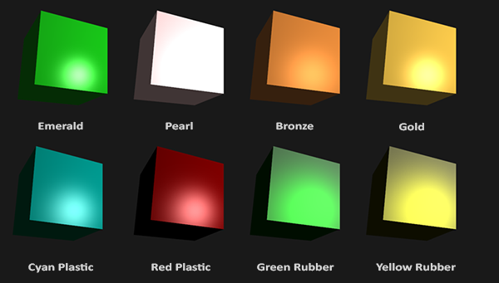
Introduction
With these 4 components that define an object's material, we can simulate many real-world materials.
The following image shows the effect that several of these real-world materials have on our cube:

Slide 11
Setting Materials
We created a uniform material struct in the fragment shader
Next, change the lighting calculations to comply with the new material properties.

Slide 12
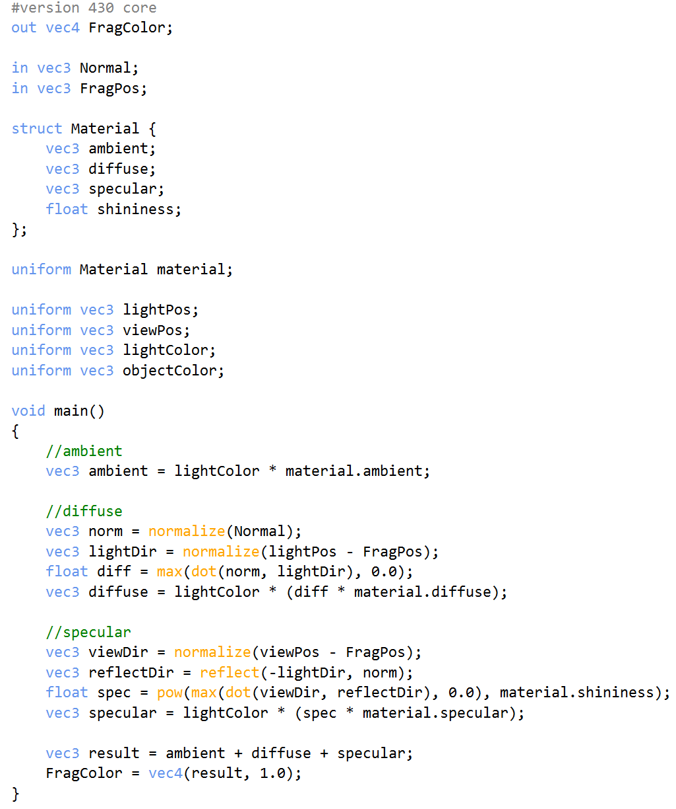
Setting Materials
All the material variables are stored in a struct.
We can access the material variables from the material uniform
We can access all of the material struct's properties wherever we need them
Calculate the resulting output color with the help of the material's colors.
Each object’s material attribute is multiplied by its respective lighting components.
2.2.3n.basic_lighting.frag

Slide 13
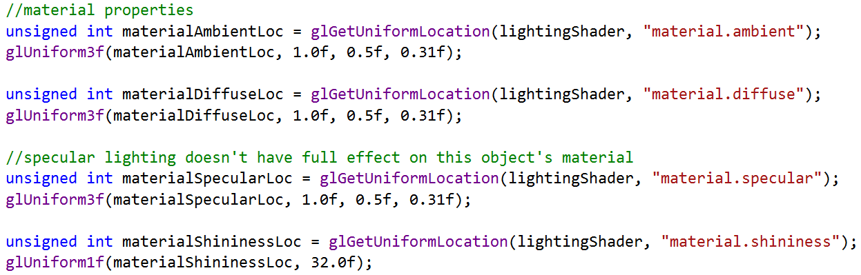
Setting Materials
We can set the material of the object in the C++/OpenGL application by setting the appropriate uniforms.
A struct in GLSL only acts as an encapsulation of uniform variables, so if we want to fill the struct, we still have to set the individual uniforms, but prefixed with the struct's name:

Slide 14
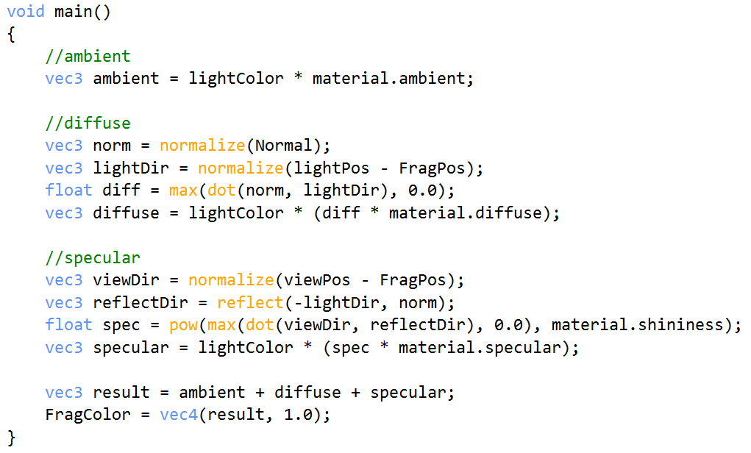
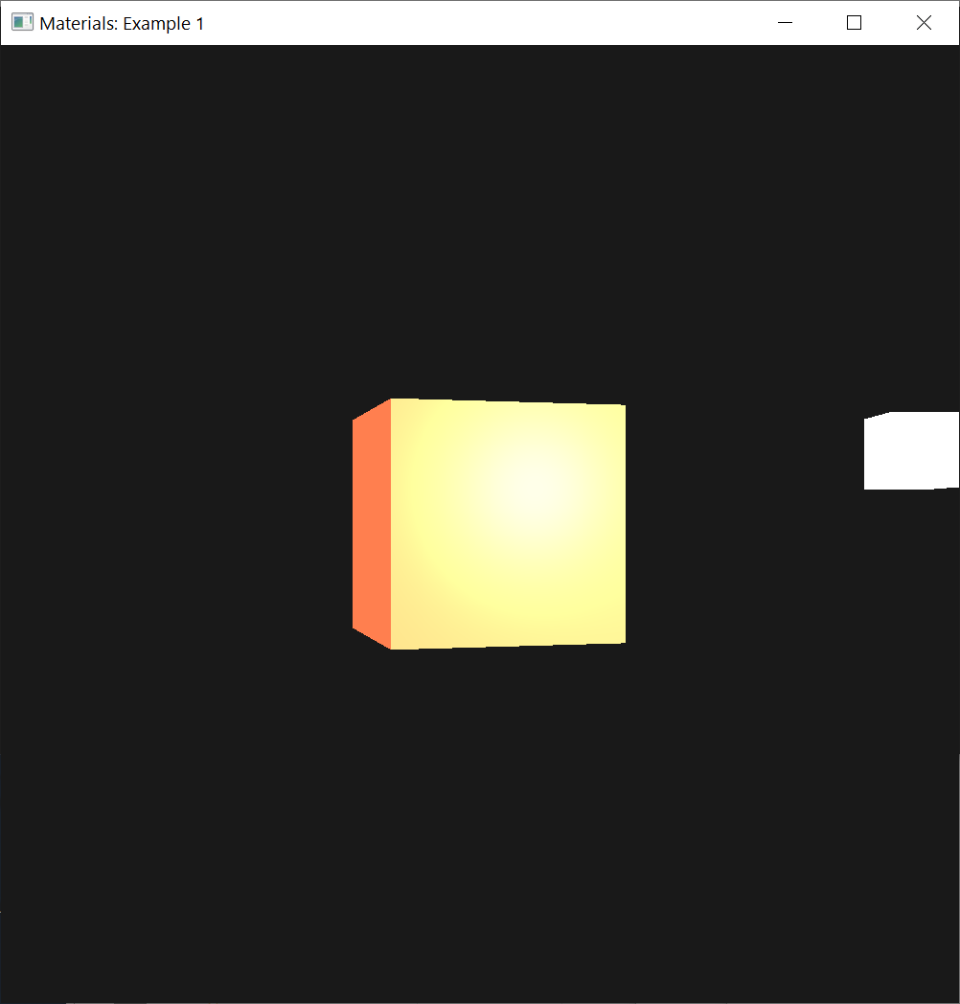
2.2.3n.basic_lighting.frag
Set the ambient and diffuse component to the color we'd like the object to have
Set the specular component of the object to a medium-bright color.
Keep the shininess at 32.
Can easily influence the object's material from the application.

Slide 15
Example: Cube’s VAO and VBO
//The cube's VAO (and VBO)
//Vertex Buffer Object (VBO)
unsigned int VBO;
//Vertex Array Object (VAO)
unsigned int cubeVAO;
unsigned int lightVAO;

Slide 16
Shader Program’s Id
//Shader Program (shaderProgram)'s ID
unsigned int lightingShader;
unsigned int lampShader;

Slide 17
Camera, Timing, and Lighting
//camera
Camera camera(glm::vec3(0.0f, 0.0f, 3.0f));
float lastX = SCR_WIDTH / 2.0f;
float lastY = SCR_HEIGHT / 2.0f;
bool firstMouse = true;
//timing
float deltaTime = 0.0f;
float lastFrame = 0.0f;
//lighting
glm::vec3 lightPos(1.2f, 0.2f, 2.0f);

Slide 18
Rotation Control Variables
//Rotation control variables
bool rotFlg1;
float angle;

Slide 19
Return ShaderProgram
//Return shaderProgram, which is used to set the shader program's ID
lightingShader = loadShader("../../src/shader/2.2.3n.basic_lighting.vert", "../../src/shader/2.2.3n.basic_lighting.frag");
lampShader = loadShader("../../src/shader/2.2.3n.lamp.vert", "../../src/shader/2.2.3n.lamp.frag");

Slide 20
Set Up Vertex Data
//set up vertex data (and buffer(s)) and configure vertex attributes
float vertices[] = {
-0.5f, -0.5f, -0.5f, 0.0f, 0.0f, -1.0f,
0.5f, -0.5f, -0.5f, 0.0f, 0.0f, -1.0f,
0.5f, 0.5f, -0.5f, 0.0f, 0.0f, -1.0f,
0.5f, 0.5f, -0.5f, 0.0f, 0.0f, -1.0f,
-0.5f, 0.5f, -0.5f, 0.0f, 0.0f, -1.0f,
-0.5f, -0.5f, -0.5f, 0.0f, 0.0f, -1.0f,
-0.5f, -0.5f, 0.5f, 0.0f, 0.0f, 1.0f,
0.5f, -0.5f, 0.5f, 0.0f, 0.0f, 1.0f,
0.5f, 0.5f, 0.5f, 0.0f, 0.0f, 1.0f,
0.5f, 0.5f, 0.5f, 0.0f, 0.0f, 1.0f,
-0.5f, 0.5f, 0.5f, 0.0f, 0.0f, 1.0f,
-0.5f, -0.5f, 0.5f, 0.0f, 0.0f, 1.0f,
-0.5f, 0.5f, 0.5f, -1.0f, 0.0f, 0.0f,
-0.5f, 0.5f, -0.5f, -1.0f, 0.0f, 0.0f,
-0.5f, -0.5f, -0.5f, -1.0f, 0.0f, 0.0f,
-0.5f, -0.5f, -0.5f, -1.0f, 0.0f, 0.0f,
-0.5f, -0.5f, 0.5f, -1.0f, 0.0f, 0.0f,
-0.5f, 0.5f, 0.5f, -1.0f, 0.0f, 0.0f,
0.5f, 0.5f, 0.5f, 1.0f, 0.0f, 0.0f,
0.5f, 0.5f, -0.5f, 1.0f, 0.0f, 0.0f,
0.5f, -0.5f, -0.5f, 1.0f, 0.0f, 0.0f,
0.5f, -0.5f, -0.5f, 1.0f, 0.0f, 0.0f,
0.5f, -0.5f, 0.5f, 1.0f, 0.0f, 0.0f,
0.5f, 0.5f, 0.5f, 1.0f, 0.0f, 0.0f,
-0.5f, -0.5f, -0.5f, 0.0f, -1.0f, 0.0f,
0.5f, -0.5f, -0.5f, 0.0f, -1.0f, 0.0f,
0.5f, -0.5f, 0.5f, 0.0f, -1.0f, 0.0f,
0.5f, -0.5f, 0.5f, 0.0f, -1.0f, 0.0f,
-0.5f, -0.5f, 0.5f, 0.0f, -1.0f, 0.0f,
-0.5f, -0.5f, -0.5f, 0.0f, -1.0f, 0.0f,
-0.5f, 0.5f, -0.5f, 0.0f, 1.0f, 0.0f,
0.5f, 0.5f, -0.5f, 0.0f, 1.0f, 0.0f,
0.5f, 0.5f, 0.5f, 0.0f, 1.0f, 0.0f,
0.5f, 0.5f, 0.5f, 0.0f, 1.0f, 0.0f,
-0.5f, 0.5f, 0.5f, 0.0f, 1.0f, 0.0f,
-0.5f, 0.5f, -0.5f, 0.0f, 1.0f, 0.0f
};

Slide 21
Configure Cube’s VAO and VBO
//first, configure the cube's VAO (and VBO)
glGenVertexArrays(1, &cubeVAO);
glGenBuffers(1, &VBO);
glBindBuffer(GL_ARRAY_BUFFER, VBO);
glBufferData(GL_ARRAY_BUFFER, sizeof(vertices), vertices, GL_STATIC_DRAW);
glBindVertexArray(cubeVAO);
//position attribute
glVertexAttribPointer(0, 3, GL_FLOAT, GL_FALSE, 6 * sizeof(float), (void*)0);
glEnableVertexAttribArray(0);
// normal attribute
glVertexAttribPointer(1, 3, GL_FLOAT, GL_FALSE, 6 * sizeof(float), (void*)(3 * sizeof(float)));
glEnableVertexAttribArray(1);

Slide 22
Configure Light’s VAO and VBO
//second, configure the light's VAO (VBO stays the same;
//the vertices are the same for the light object, which is also a 3D cube)
glGenVertexArrays(1, &lightVAO);
glBindVertexArray(lightVAO);
//we only need to bind to the VBO (to link it with glVertexAttribPointer),
//no need to fill it;
//the VBO's data already contains all we need
//(it's already bound, but we do it again for educational purposes)
glBindBuffer(GL_ARRAY_BUFFER, VBO);
//note that we update the lamp's position attribute's stride to reflect
//the updated buffer data
glVertexAttribPointer(0, 3, GL_FLOAT, GL_FALSE, 6 * sizeof(float), (void*)0);
glEnableVertexAttribArray(0);

Slide 23
Initialize Rotation Control Variables
//Initialize rotation control variables
rotFlg1 = false;
angle = 0.0f;

Slide 24
Cube’s Vertex Shader: 2.2.3n.basic_lighting.vert
#version 460 core
layout (location = 0) in vec3 aPos;
layout (location = 1) in vec3 aNormal;
out vec3 FragPos;
out vec3 Normal;
uniform mat4 model;
uniform mat4 view;
uniform mat4 projection;
void main()
{
FragPos = vec3(model * vec4(aPos, 1.0));
Normal = mat3(transpose(inverse(model))) * aNormal;
gl_Position = projection * view * vec4(FragPos, 1.0);
}

Slide 25
Cube’s Fragment Shader: 2.2.3n.basic_lighting.frag
#version 460 core
out vec4 FragColor;
in vec3 Normal;
in vec3 FragPos;
struct Material {
vec3 ambient;
vec3 diffuse;
vec3 specular;
float shininess;
};
uniform Material material;
uniform vec3 lightPos;
uniform vec3 viewPos;
uniform vec3 lightColor;
uniform vec3 objectColor;
void main()
{
//ambient
vec3 ambient = lightColor * material.ambient;
//diffuse
vec3 norm = normalize(Normal);
vec3 lightDir = normalize(lightPos - FragPos);
float diff = max(dot(norm, lightDir), 0.0);
vec3 diffuse = lightColor * (diff * material.diffuse);
//specular
vec3 viewDir = normalize(viewPos - FragPos);
vec3 reflectDir = reflect(-lightDir, norm);
float spec = pow(max(dot(viewDir, reflectDir), 0.0), material.shininess);
vec3 specular = lightColor * (spec * material.specular);
vec3 result = ambient + diffuse + specular;
FragColor = vec4(result, 1.0);
}

Slide 26
Cube’s Fragment Shader: 2.2.3n.basic_lighting.frag
#version 460 core
out vec4 FragColor;
in vec3 Normal;
in vec3 FragPos;
struct Material {
vec3 ambient;
vec3 diffuse;
vec3 specular;
float shininess;
};
uniform Material material;
uniform vec3 lightPos;
uniform vec3 viewPos;
uniform vec3 lightColor;
uniform vec3 objectColor;

Slide 27
Cube’s Fragment Shader: 2.2.3n.basic_lighting.frag
void main()
{
//ambient
vec3 ambient = lightColor * material.ambient;
//diffuse
vec3 norm = normalize(Normal);
vec3 lightDir = normalize(lightPos - FragPos);
float diff = max(dot(norm, lightDir), 0.0);
vec3 diffuse = lightColor * (diff * material.diffuse);
//specular
vec3 viewDir = normalize(viewPos - FragPos);
vec3 reflectDir = reflect(-lightDir, norm);
float spec = pow(max(dot(viewDir, reflectDir), 0.0), material.shininess);
vec3 specular = lightColor * (spec * material.specular);
vec3 result = ambient + diffuse + specular;
FragColor = vec4(result, 1.0);
}

Slide 28
Lamp’s Vertex Shader: 2.2.3n.lamp.vert
#version 460 core
layout (location = 0) in vec3 aPos;
uniform mat4 model;
uniform mat4 view;
uniform mat4 projection;
void main()
{
gl_Position = projection * view * model * vec4(aPos, 1.0);
}

Slide 29
Lamp’s Fragment Shader: 2.2.3n.lamp.frag
#version 460 core
out vec4 FragColor;
void main()
{
FragColor = vec4(1.0); // set alle 4 vector values to 1.0
}

Slide 30
Active Shader: lightingShader
//activate shader: lightingShader
//be sure to activate shader when setting uniforms/drawing objects
glUseProgram(lightingShader);
unsigned int objectColorLoc = glGetUniformLocation(lightingShader, "objectColor");
glUniform3f(objectColorLoc, 1.0f, 0.5f, 0.31f);
unsigned int lightColorLoc = glGetUniformLocation(lightingShader, "lightColor");
glUniform3f(lightColorLoc, 1.0f, 1.0f, 1.0f);
unsigned int lightPosLoc = glGetUniformLocation(lightingShader, "lightPos");
glUniform3f(lightPosLoc, lightPos.x, lightPos.y, lightPos.z);
unsigned int cameraPosLoc = glGetUniformLocation(lightingShader, "viewPos");
glUniform3f(cameraPosLoc, camera.Position.x, camera.Position.y, camera.Position.z);

Slide 31
Setting Material Properties
//Setting material properties
unsigned int materialAmbientLoc = glGetUniformLocation(lightingShader, "material.ambient");
glUniform3f(materialAmbientLoc, 1.0f, 0.5f, 0.31f);
unsigned int materialDiffuseLoc = glGetUniformLocation(lightingShader, "material.diffuse");
glUniform3f(materialDiffuseLoc, 1.0f, 0.5f, 0.31f);
//Setting specular lighting doesn't have full effect on this object's material
unsigned int materialSpecularLoc = glGetUniformLocation(lightingShader, "material.specular");
glUniform3f(materialSpecularLoc, 1.0f, 0.5f, 0.31f);
unsigned int materialShininessLoc = glGetUniformLocation(lightingShader, "material.shininess");
glUniform1f(materialShininessLoc, 32.0f);

Slide 32
View/Projection Transformations
//view/projection transformations
glm::mat4 projection = glm::perspective(glm::radians(camera.Zoom), (float)SCR_WIDTH / (float)SCR_HEIGHT, 0.1f, 100.0f);
glm::mat4 view = camera.GetViewMatrix();
unsigned int projectionLoc = glGetUniformLocation(lightingShader, "projection");
glUniformMatrix4fv(projectionLoc, 1, GL_FALSE, glm::value_ptr(projection));
unsigned int viewLoc = glGetUniformLocation(lightingShader, "view");
glUniformMatrix4fv(viewLoc, 1, GL_FALSE, glm::value_ptr(view));

Slide 33
World Transformation
//world transformation
glm::mat4 model = glm::mat4(1.0f);
//model1 = glm::scale(model1, glm::vec3(1.0f));
if (rotFlg1)
{
angle = (float)glfwGetTime()/2.0;
model = glm::rotate(model, angle, glm::vec3(0.0f, 1.0f, 0.0f));
}
else {
model = glm::rotate(model, angle, glm::vec3(0.0f, 1.0f, 0.0f));
}
unsigned int modelLoc = glGetUniformLocation(lightingShader, "model");
glUniformMatrix4fv(modelLoc, 1, GL_FALSE, glm::value_ptr(model));

Slide 34
Render the Cube
//render the cube
glBindVertexArray(cubeVAO);
glDrawArrays(GL_TRIANGLES, 0, 36);

Slide 35
Active Shader: lampShader
//Activate shader: lampShader
//also draw the lamp object
glUseProgram(lampShader);
projectionLoc = glGetUniformLocation(lampShader, "projection");
glUniformMatrix4fv(projectionLoc, 1, GL_FALSE, glm::value_ptr(projection));
viewLoc = glGetUniformLocation(lampShader, "view");
glUniformMatrix4fv(viewLoc, 1, GL_FALSE, glm::value_ptr(view));

Slide 36
World Transformation
//world transformation
model = glm::mat4(1.0f);
model = glm::translate(model, lightPos);
model = glm::scale(model, glm::vec3(0.2f)); // a smaller cube
modelLoc = glGetUniformLocation(lampShader, "model");
glUniformMatrix4fv(modelLoc, 1, GL_FALSE, glm::value_ptr(model));

Slide 37
Render the Lamp
//render the lamp
glBindVertexArray(lightVAO);
glDrawArrays(GL_TRIANGLES, 0, 36);

Slide 38
Release Used Resources
//Release used resources
//Optional: de-allocate all resources once they've outlived their purpose:
glDeleteVertexArrays(1, &cubeVAO);
glDeleteVertexArrays(1, &lightVAO);
glDeleteBuffers(1, &VBO);

Slide 39
Key Controls of Object Movement
//Key controls of object movement
if (glfwGetKey(window, GLFW_KEY_W) == GLFW_PRESS)
camera.ProcessKeyboard(FORWARD, deltaTime);
if (glfwGetKey(window, GLFW_KEY_S) == GLFW_PRESS)
camera.ProcessKeyboard(BACKWARD, deltaTime);
if (glfwGetKey(window, GLFW_KEY_A) == GLFW_PRESS)
camera.ProcessKeyboard(LEFT, deltaTime);
if (glfwGetKey(window, GLFW_KEY_D) == GLFW_PRESS)
camera.ProcessKeyboard(RIGHT, deltaTime);
if (glfwGetKey(window, GLFW_KEY_R) == GLFW_PRESS) {
rotFlg1 = true;
}
else if (glfwGetKey(window, GLFW_KEY_P) == GLFW_PRESS) {
rotFlg1 = false;
}

Slide 40
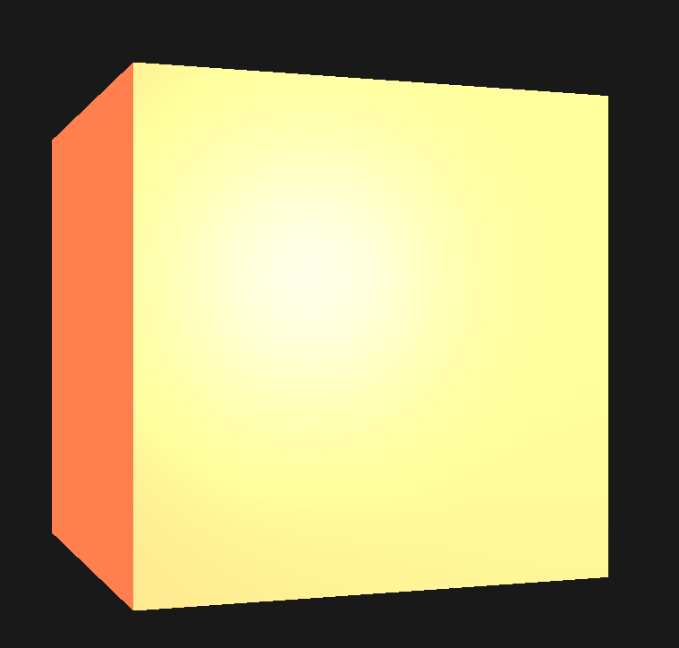
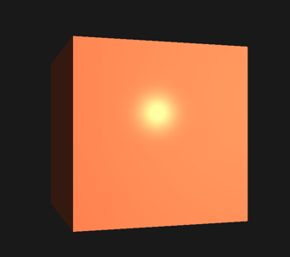
Light Properties
The object is too bright.
The ambient, diffuse, and specular colors are reflected with full force from any light source.
Light sources have different intensities for their ambient, diffuse, and specular components.
In the previous lecture, we solved this by varying the ambient and specular intensities with a strength value:
ambientStrength and specularStrength.

Slide 41
Light Properties
#version 460 core
out vec4 FragColor;
in vec3 Normal;
in vec3 FragPos;
struct Material {
vec3 ambient;
vec3 diffuse;
vec3 specular;
float shininess;
};
uniform Material material;
uniform vec3 lightPos;
uniform vec3 viewPos;
uniform vec3 lightColor;
uniform vec3 objectColor;
//set lightColor to vec3(1.0)
vec3 lightColor = vec3(1.0);
We want to do something similar, but this time by specifying intensity vectors for each lighting component.
If we'd visualize lightColor as vec3(1.0) the GLSL code would look like the right-side fragment shader
Update 2.2.3n.basic_lighting.frag
//set lightColor to vec3(1.0)
vec3 lightColor = vec3(1.0);

Slide 42
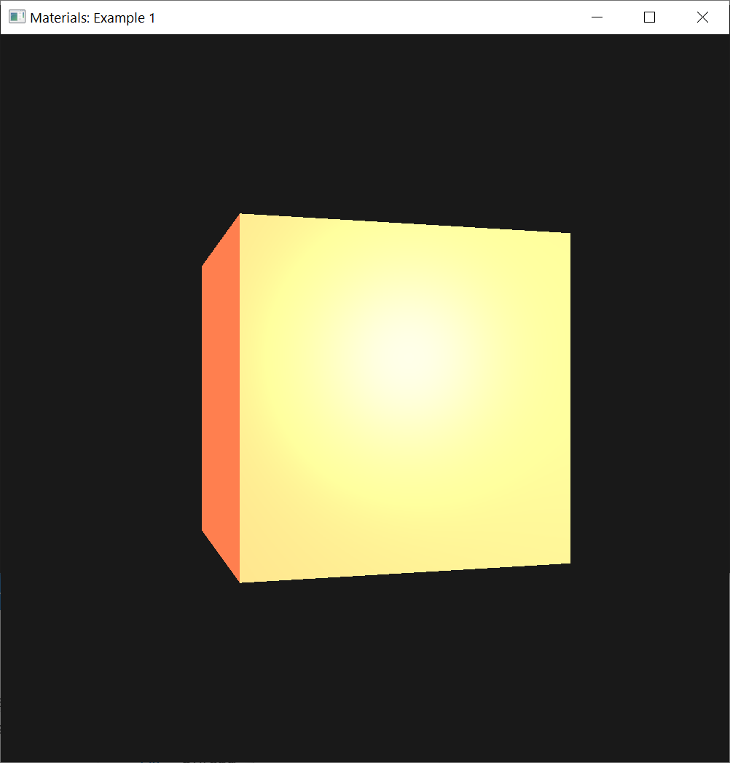
Light Properties
Each material property of the object is returned with full intensity for each of the light's components.
These vec3(1.0) values can be influenced individually as well for each light source, and this is usually what we want.

Slide 43
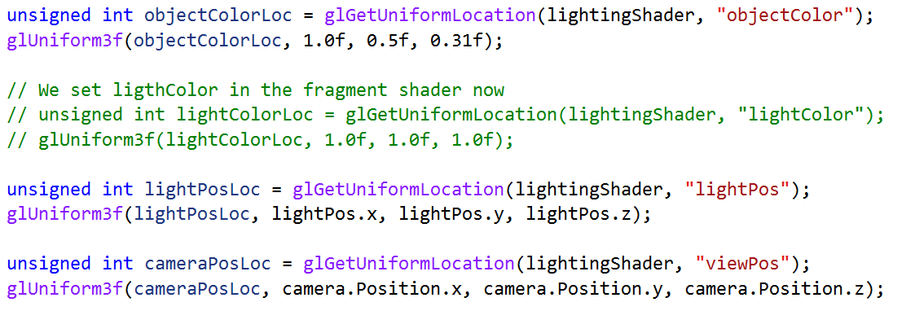
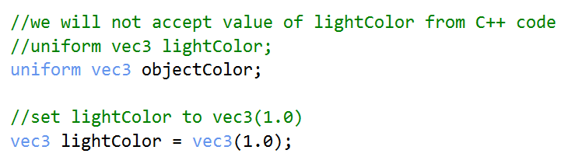
Light Properties
We set ligthColor in the fragment shader now

Slide 44
Update 2.2.3n.basic_lighting.frag
#version 460 core
out vec4 FragColor;
in vec3 Normal;
in vec3 FragPos;
struct Material {
vec3 ambient;
vec3 diffuse;
vec3 specular;
float shininess;
};
uniform Material material;
uniform vec3 lightPos;
uniform vec3 viewPos;
//uniform vec3 lightColor;
uniform vec3 objectColor;
//set lightColor to vec3(1.0)
vec3 lightColor = vec3(0.3);

Slide 45
void main()
{
//ambient
vec3 ambient = lightColor * material.ambient;
//diffuse
vec3 norm = normalize(Normal);
vec3 lightDir = normalize(lightPos - FragPos);
float diff = max(dot(norm, lightDir), 0.0);
vec3 diffuse = lightColor * (diff * material.diffuse);
//specular
vec3 viewDir = normalize(viewPos - FragPos);
vec3 reflectDir = reflect(-lightDir, norm);
float spec = pow(max(dot(viewDir, reflectDir), 0.0), material.shininess);
vec3 specular = lightColor * (spec * material.specular);
vec3 result = ambient + diffuse + specular;
FragColor = vec4(result, 1.0);
}

Slide 46
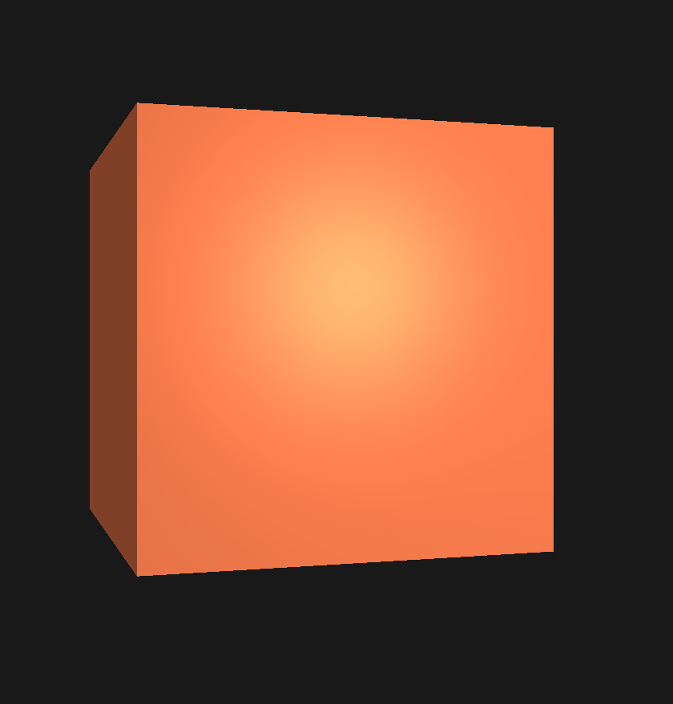

Light Properties
The ambient component of the object is fully influencing the color of the cube, but the ambient component shouldn't really have such a big impact on the final color
Can restrict the ambient color by setting the light's ambient intensity to a lower value
vec3 lightColor = vec3(0.5);
vec3 lightColor = vec3(1.0);

Slide 47
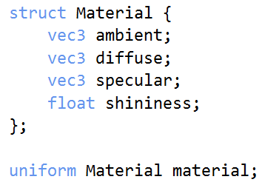
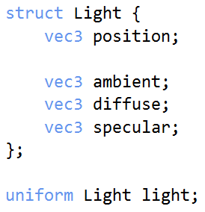
Light Properties
We can influence the diffuse and specular intensity of the light source in the same way
Want to create something similar to the material struct for the light properties:

Slide 48
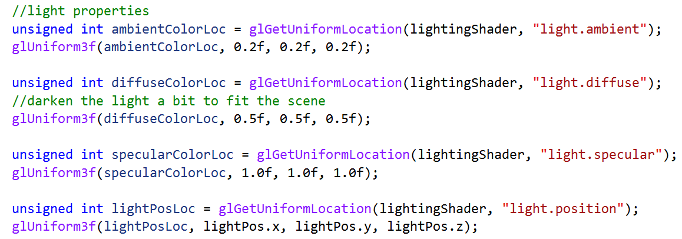
Light Properties
A light source has a different intensity for its ambient, diffuse, and specular light.
The ambient light is usually set to a low intensity: don't want the ambient color to be too dominant.
2.2.3n2.basic_lighting.frag
The diffuse component of a light source is usually set a bright white color.
The specular component is usually kept at vec3(1.0) shining at full intensity.
Add the light's position vector to the struct.

Slide 49
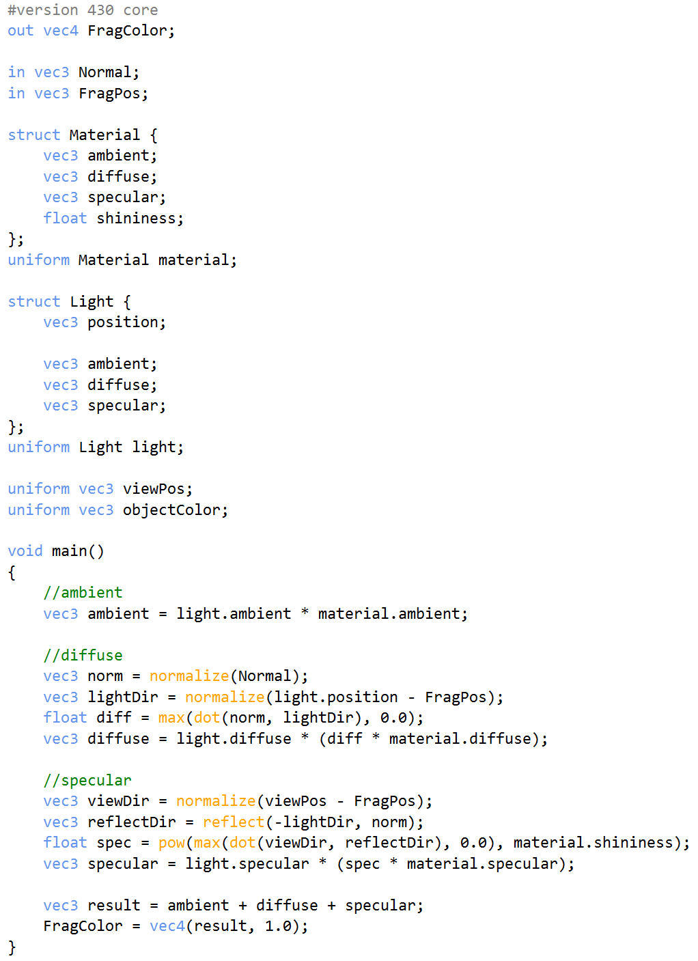
Light Properties
We need to use uniform variable light to update the fragment shader:
2.2.3n2.basic_lighting.frag

Slide 50
2.2.3n.basic_lighting_v2.frag
#version 460 core
out vec4 FragColor;
in vec3 Normal;
in vec3 FragPos;
struct Material {
vec3 ambient;
vec3 diffuse;
vec3 specular;
float shininess;
};
uniform Material material;
struct Light {
vec3 position;
vec3 ambient;
vec3 diffuse;
vec3 specular;
};
uniform Light light;
uniform vec3 viewPos;
uniform vec3 objectColor;

Slide 51
2.2.3n.basic_lighting_v2.frag
void main()
{
//ambient
vec3 ambient = light.ambient * material.ambient;
//diffuse
vec3 norm = normalize(Normal);
vec3 lightDir = normalize(light.position - FragPos);
float diff = max(dot(norm, lightDir), 0.0);
vec3 diffuse = light.diffuse * (diff * material.diffuse);
//specular
vec3 viewDir = normalize(viewPos - FragPos);
vec3 reflectDir = reflect(-lightDir, norm);
float spec = pow(max(dot(viewDir, reflectDir), 0.0), material.shininess);
vec3 specular = light.specular * (spec * material.specular);
vec3 result = ambient + diffuse + specular;
FragColor = vec4(result, 1.0);
}

Slide 52
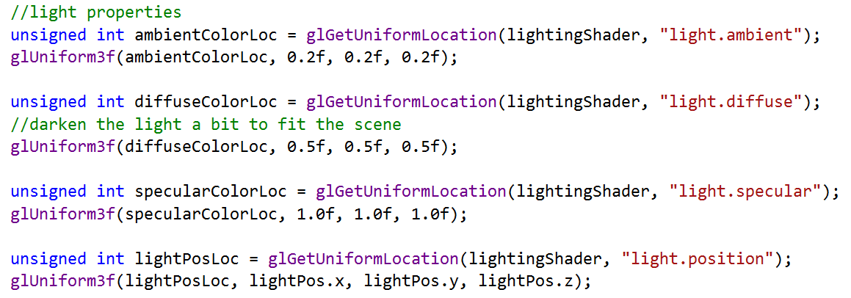
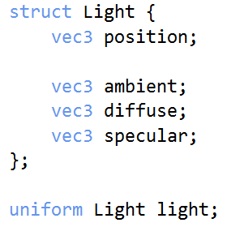
Light Properties
Then set the light intensities and position in the application:
C++ and OpenGL application
Fragment shader

Slide 53
Update Shader Loading
//Return shaderProgram, which is used to set the shader program's ID
//lightingShader = loadShader("../../src/shader/2.2.3n.basic_lighting.vert", "../../src/shader/2.2.3n.basic_lighting.frag");
lightingShader = loadShader("../../src/shader/2.2.3n.basic_lighting.vert", "../../src/shader/2.2.3n.basic_lighting_v2.frag");

Slide 54
Update Lighting Properties
//unsigned int lightPosLoc = glGetUniformLocation(lightingShader, "lightPos");
//glUniform3f(lightPosLoc, lightPos.x, lightPos.y, lightPos.z);
//light properties
unsigned int ambientColorLoc = glGetUniformLocation(lightingShader, "light.ambient");
glUniform3f(ambientColorLoc, 0.2f, 0.2f, 0.2f);
//glUniform3f(ambientColorLoc, 0.9f, 0.9f, 0.9f);
unsigned int diffuseColorLoc = glGetUniformLocation(lightingShader, "light.diffuse");
//darken the light a bit to fit the scene
glUniform3f(diffuseColorLoc, 0.5f, 0.5f, 0.5f);
unsigned int specularColorLoc = glGetUniformLocation(lightingShader, "light.specular");
glUniform3f(specularColorLoc, 1.0f, 1.0f, 1.0f);
unsigned int lightPosLoc = glGetUniformLocation(lightingShader, "light.position");
glUniform3f(lightPosLoc, lightPos.x, lightPos.y, lightPos.z);

Slide 55
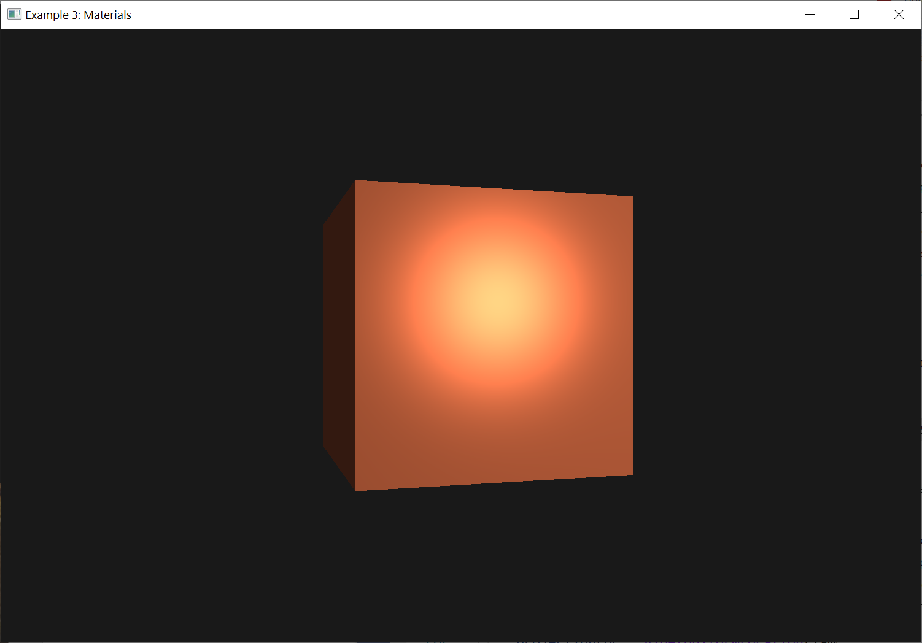
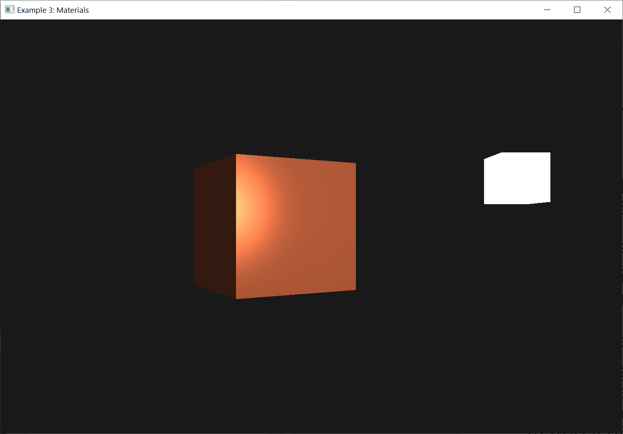
Light Properties
We modulated how the light influences all the objects' materials
We get a visual output that looks much like the output from the last lecture.
This time, got full control over the lighting and the material of the object

Slide 56
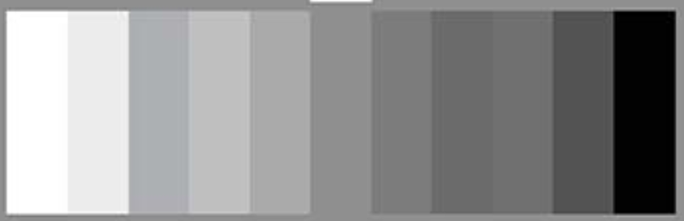
Different light colors
So far, we used light colors to only vary the intensity of their individual components by choosing colors that range from white to gray to black
We are not affecting the actual colors of the object (only its intensity).

Slide 57
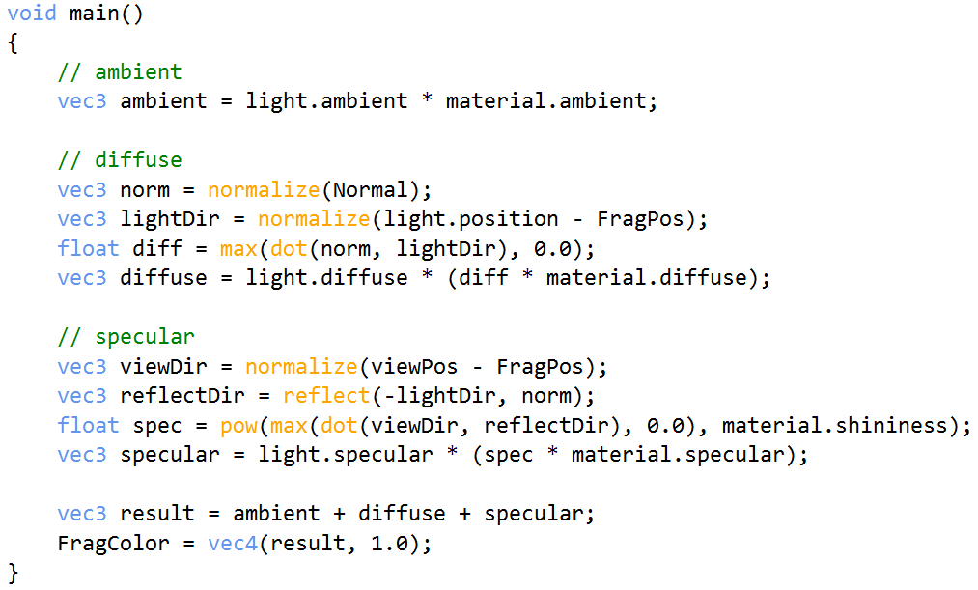
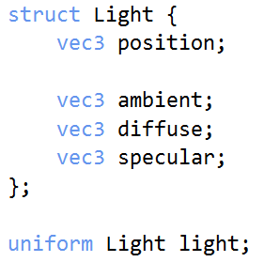
Different light colors
Now we have easy access to the light's properties, we can change their colors over time to get some interesting effects.
Since everything is already set up in the fragment shader, changing the light's colors is easy
2.2.3n2.basic_lighting.frag

Slide 58
Different light colors
A different light color can greatly influence the object's color output.
We can easily change the light's colors over time by changing the light's ambient and diffuse colors via sin and glfwGetTime() :

Slide 59
Update Light Properties for Different Colors
//Update light properties for different colors
glm::vec3 lightColor;
lightColor.x = sin(glfwGetTime() * 2.0f);
lightColor.y = sin(glfwGetTime() * 0.7f);
lightColor.z = sin(glfwGetTime() * 1.3f);
glm::vec3 diffuseColor = lightColor * glm::vec3(0.5f); //decrease the influence
glm::vec3 ambientColor = diffuseColor * glm::vec3(0.2f); //low influence
//light properties
unsigned int ambientColorLoc = glGetUniformLocation(lightingShader, "light.ambient");
glUniform3f(ambientColorLoc, ambientColor.r, ambientColor.g, ambientColor.b);
unsigned int diffuseColorLoc = glGetUniformLocation(lightingShader, "light.diffuse");
glUniform3f(diffuseColorLoc, diffuseColor.r, diffuseColor.g, diffuseColor.b);

Slide 60
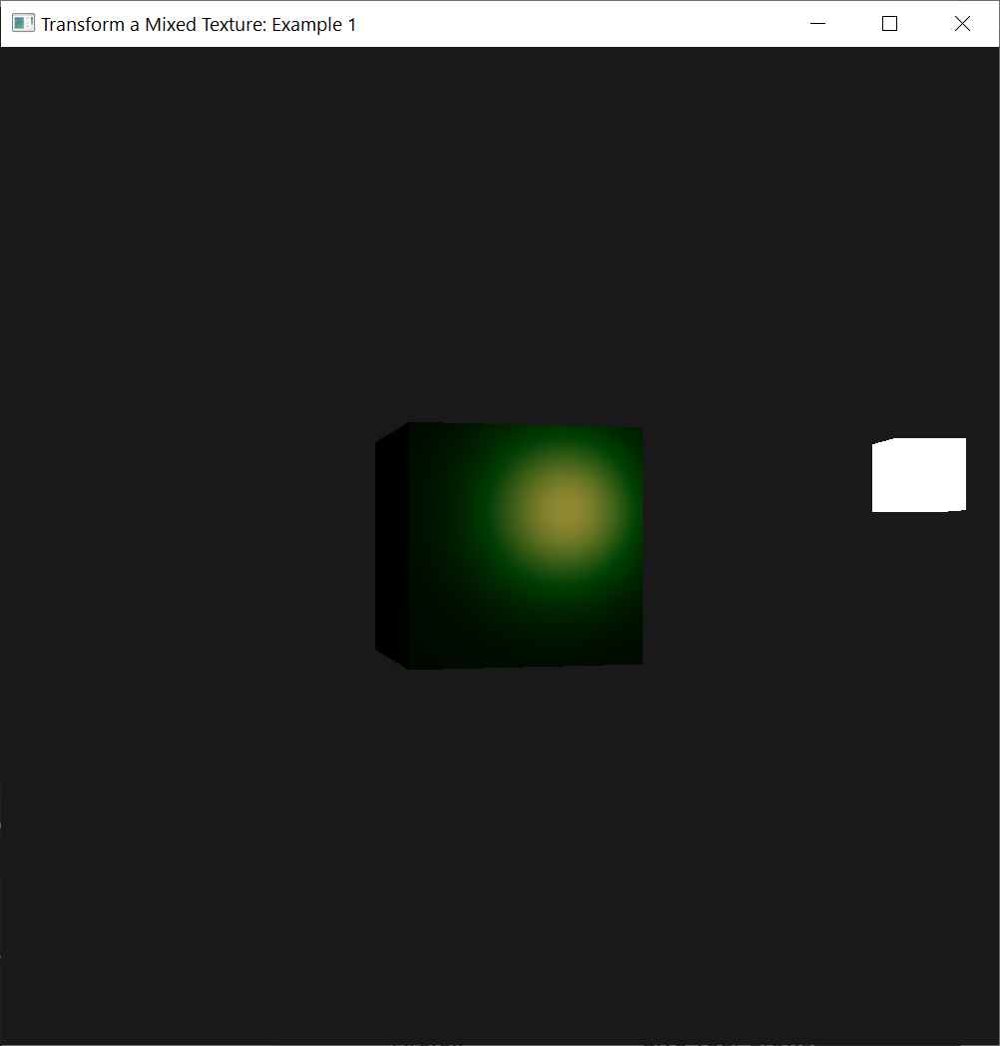
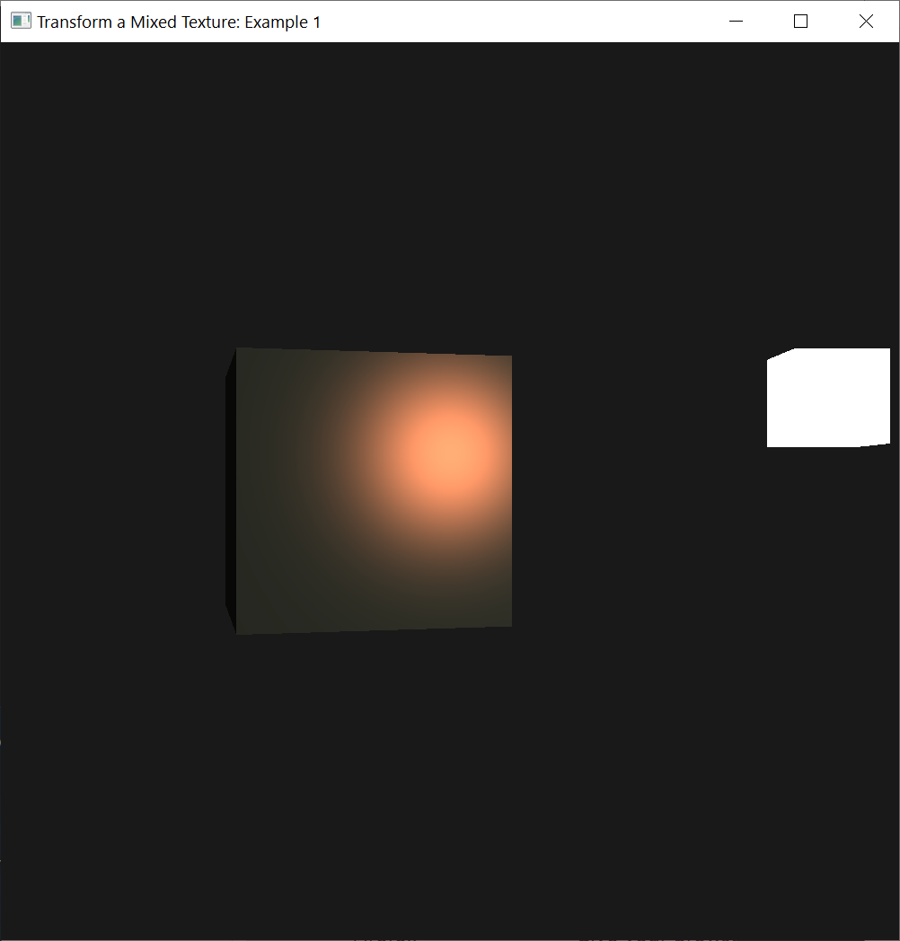
Different light colors

Slide 61
Exercise
Simulate some of the real-world objects by defining their respective materials

Slide 62
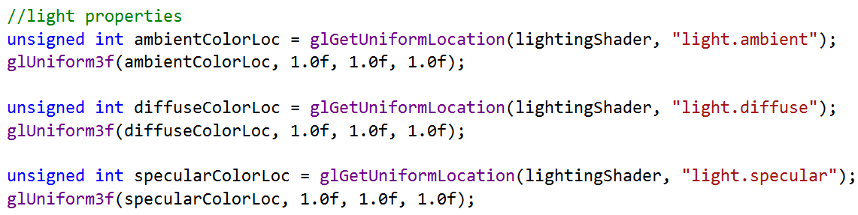
Exercise 1
Update example2.cpp
Set all light colors to full intensity

Slide 63
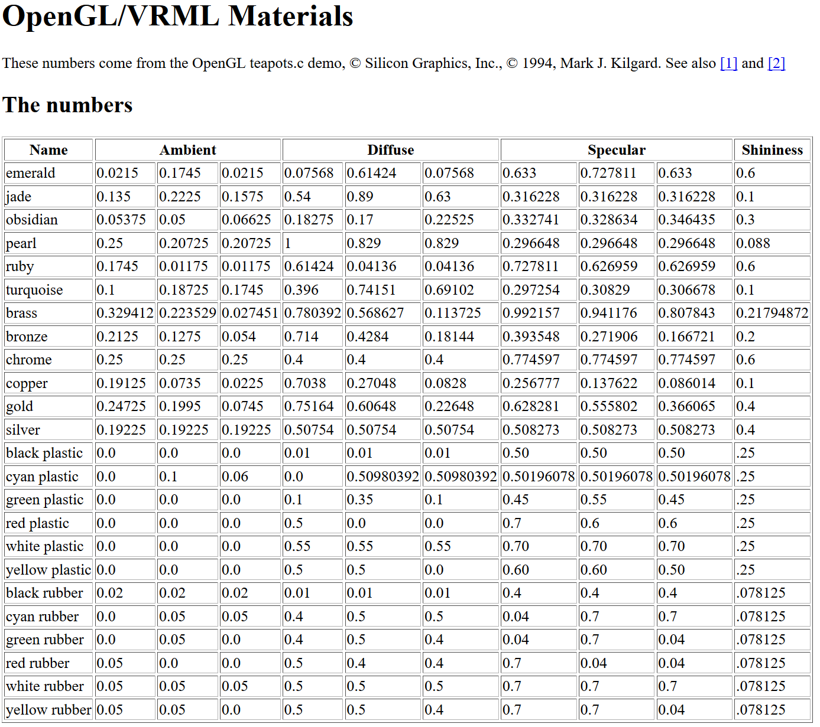
Work
Use this table to set the material properties to cyan plastic: ambient, diffuse, and specular
Shininess keeps to 32.0f.
http://devernay.free.fr/cours/opengl/materials.html

Slide 64
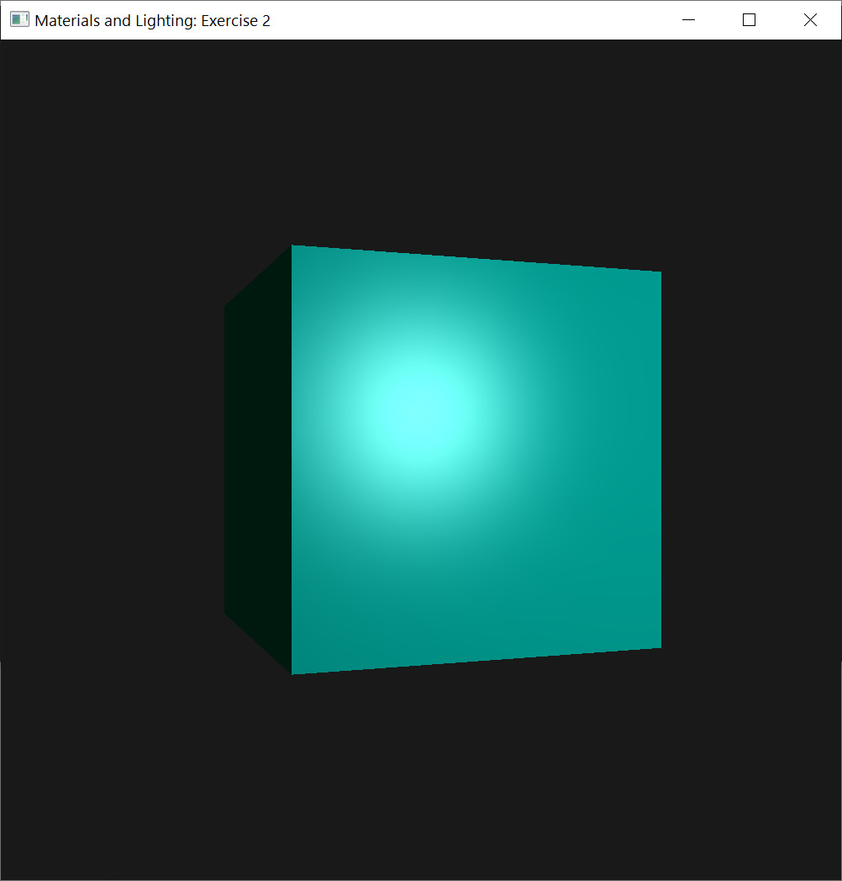
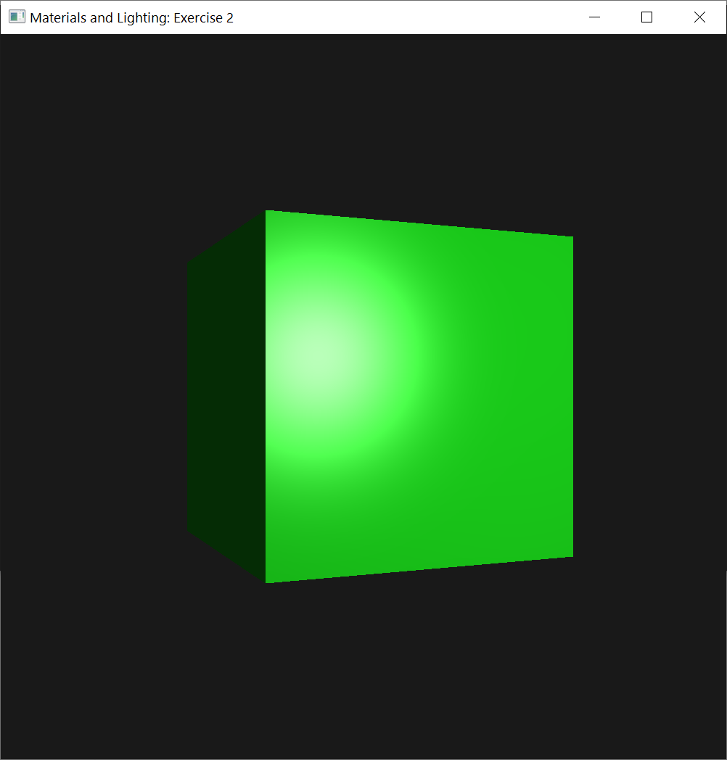
Work
Update exercise 1: initial material is cyan plastic
When press “E/e” key, the material will be updated to emerald
When press “C/c” key, the material will be recovered to cyan plastic
Press “C/c” key: cyan plastic
Press “E/e” key: emerald

